Slide 1
Humiture sensor Module
Bradey Brito-Garcia n01111786

Slide 2
Background
A DHT (11, 22, AM2302) sensor module consist of a capacitive humidity sensor and a thermistor, it uses them to monitor the temperature / humidity of an area. The signal can be read by most modern microcontrollers. The information from these sensors could then be potentially sent to a database and viewed by specific users.

Slide 3
Components
The two main items needed to complete a humiture sensor build are;
Raspberry pi
DHT sensor
You will also need
Breadboard
Resistors
Connecting wires
See my build video for a more detailed list
The code I used was written in Python (available on my github), I sourced it from Adafruit.

Slide 4
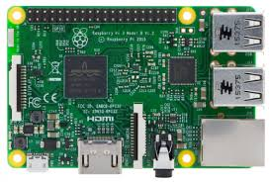
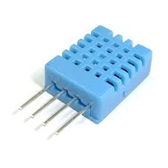
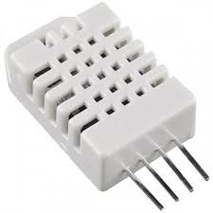
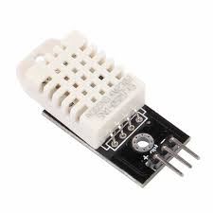
Budget
Raspberry Pi 3 Starter kit - $99.99 - Amazon
Sunfounder DHT (11, 22, 2304) - $13.99 - Amazon
Parts kit

Slide 5
DHT 11 VS 22
11
Super Low cost
0-50°C
20-80% humidity
22
Low cost
-40 - 80°C
0-100% humidity

Slide 6
Conclusion
The schedule plan made in week 3 was only used as reference due to the rearranging of actions the strike did. The progression of my project has proceeded very well regardless.
To run The Python program, you can simply type this command into the terminal window on the raspberry pi.
sudo /home/pi/Adafruit_Python_DHT/examples/AdafruitDHT.py 2302 4
4 represents the pin receiving the signal

